Slide 1
Machine Learning Strategies for Chemistry Tabulation and Lookup
Amol Salunkhe, Siddhant Aphale, Paul Desjardin and Varun Chandola

Slide 2
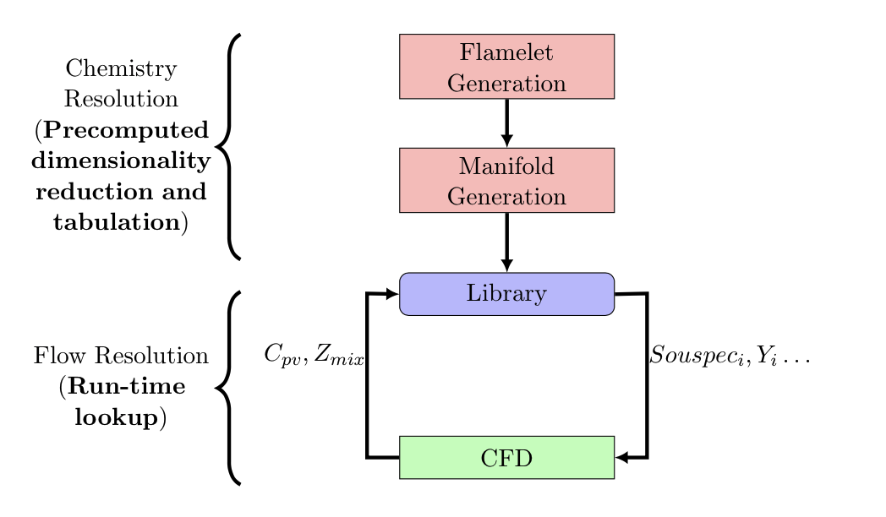
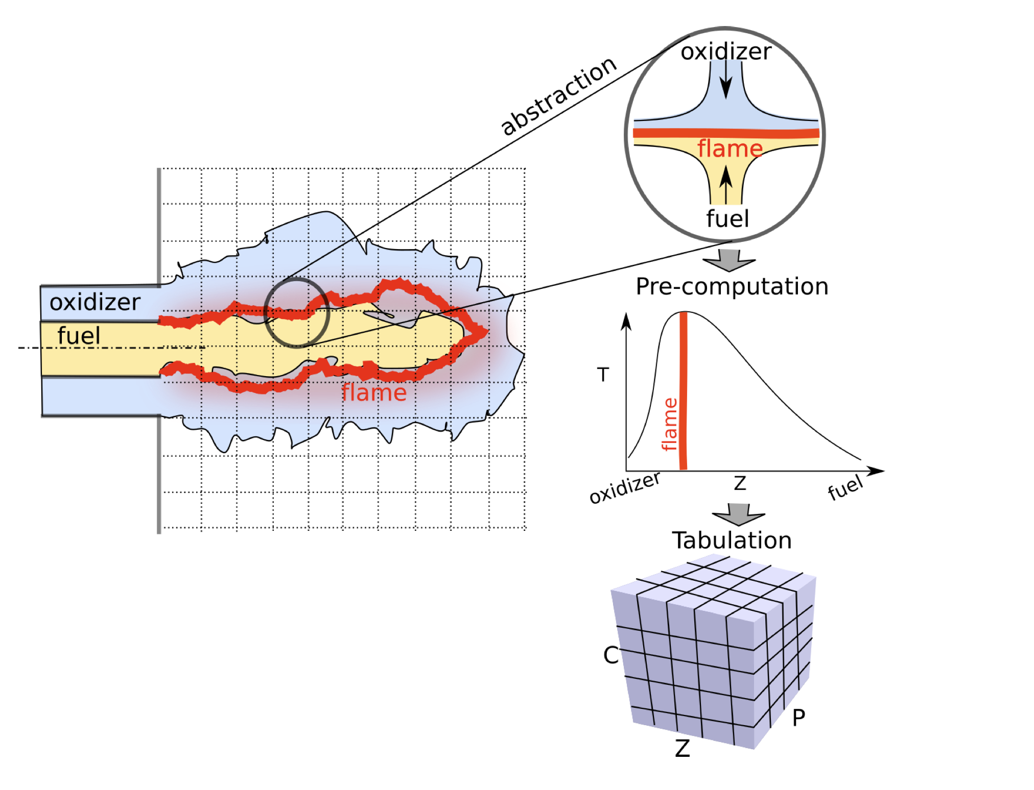
Turbulent Combustion Modeling
Numerical simulations of turbulent combustion problems is expensive
Large number of molecular species present
Large disparity between the scales for the flame (combustion) and the flow
A typical model reduction strategy is to project the high-dimensional thermochemical state-space on a low-dimensional manifold
The state-space is precomputed and parameterized in terms of a reduced set of scalar variables (tabulation)
The flow system is solved using the scalar variables (model reduction)
The full state space (chemistry) is efficiently looked up during run-time
Advantage: decouple the turbulent flow field (exists at a coarser time/spatial scale) and the chemical reactions (exist at a much finer time/spatial scale)
Src: S. Bhalla et al., 2019, ECML-PKDD

Slide 3
Reducing Chemistry
The thermochemical manifold is parameterized using:
Conserved scalar (mixture fraction, Z)
Reaction progress variables (e.g., C_{pv} in Bojko and Desjardin, 2016)
The reaction progress variable, C, can be calculated in several ways
Intrinsic low dimensional manifold (ILDM – Mass and Pope, 1992)
Flame Generation Manifolds (FGM)
Guiding principles for C
C1 - Result in transport equation that can be conveniently solved
C2 - The reactive scalars should evolve on comparable time scales
C3 - Parameters should be independent of each other
C4 - A bijective mapping from manifold space to the thermo-chemical state space

Slide 4
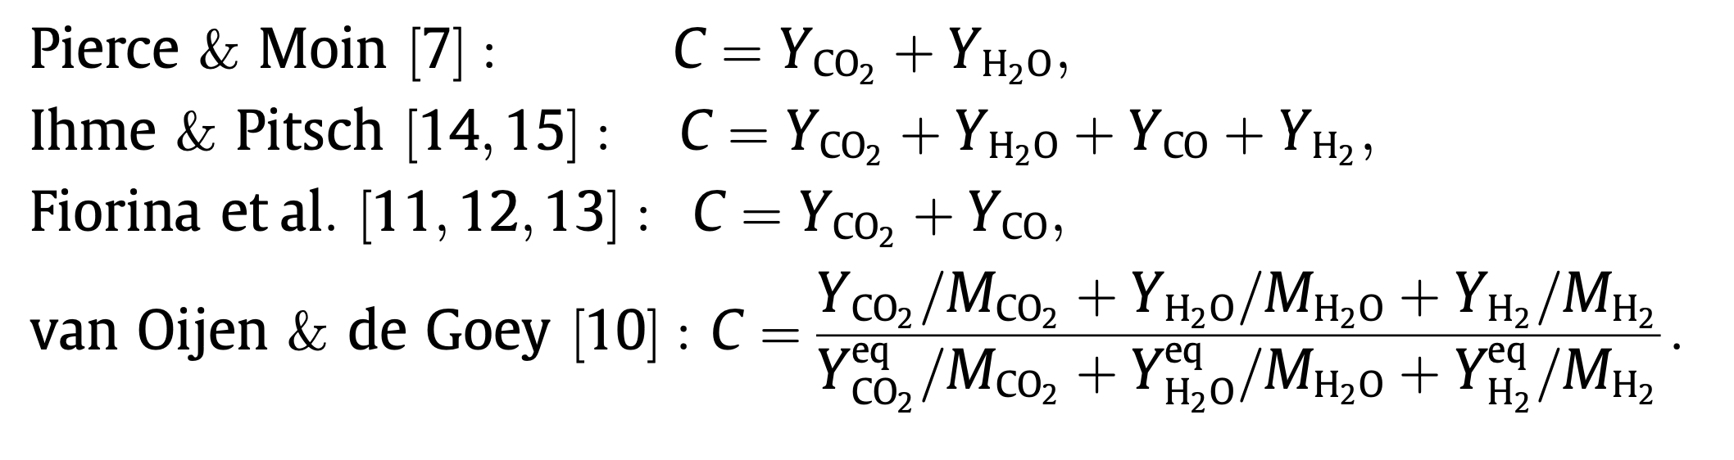
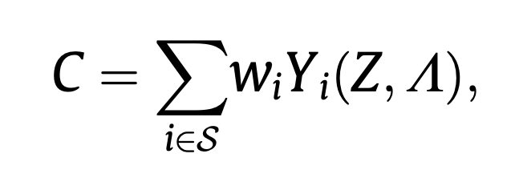
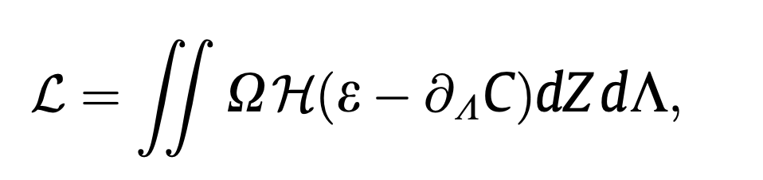
Example of existing approaches
Fixed expressions
Data-driven calculations
The weights are estimated by optimizing over a cost-function that imposes the monotonicity requirement (for C4)

Slide 5
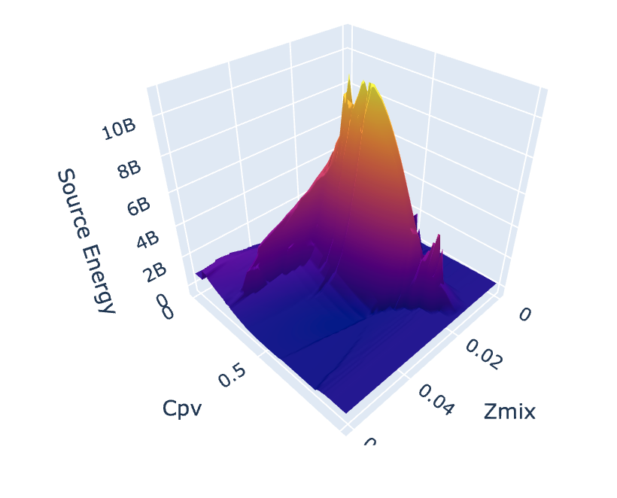
Run-time lookup
The mapping from lower-dimensional manifold parameterized by (Z_{mix}, C_{pv}) to the state variables is pre-computed and tabulated
At run-time, for a new value of (Z_{mix}, C_{pv}), a “look-up” is performed
Lagrange interpolation

Slide 6
Issues
The look-up could be computationally inefficient
In order to satisfy C4 (bijective mapping), several flames in the original data are removed before building the look-up table
Inaccurate estimation of the thermochemical space
This could be improved by including more progress variables
Would make interpolation even more inefficient
Polynomial growth of the look-up table

Slide 7
Proposed Machine Learning Based Framework 1
Step 1: Use principal component analysis (PCA) to learn the progress variables
Linear combination of the species, so transport equation in the reduced space is convenient to solve (C1)
Combines similarly evolving species (C2)
Orthogonal basis vectors (C3)
A constrained PCA formulation can be used to include Z_{mix}
However, it does not guarantee a smooth manifold over the state variables for efficient lookup (C4)
Adding more PCA components would help
Step 2: Use a non-linear machine learning model to replace the tabular lookup
A Gaussian Process Regression model
Also provides uncertainties with the predictions
Computationally inefficient
A neural network
Could be computationally inefficient

Slide 8
Proposed Machine Learning Based Framework 1
ML predictive model
Constrained PCA
Low-dimensional state
High dimensional input vector
Thermochemical state variables
Pre-computation
Run-time

Slide 9
Results so far
Tested constrained PCA + Gaussian Process Regression (GPR) on multiple scenarios (CH4 + Air, Wax + Air)
Evaluated on the predictive accuracy for the source energy term
Improvements over the current tabulated framework
Especially when the low-dimensional state is increased to 5
Switching GPR for a neural network did not improve the results

Slide 10
Proposed Machine Learning Based Framework 2
The reduction and the ML model lookup steps are decoupled in the first framework
PCA focuses on maximizing the variance of the high-dimensional data in the low-dimensional reduction (C1, C2, C3)
Is not necessarily informed by the subsequent task of predicting the high-dimensional state (C4)
The second framework combines the two steps into a coupled neural network architecture

Slide 11
Proposed Machine Learning Based Framework 2
Neural network 1
The first neural network is trained to accurately predict the target state variables (source energy, temperature, etc.) from the input high-dimensional input vector
The first layer has a linear activation and a bottleneck – width of the layer corresponds to the dimensionality of the reduced space
Linear layer
High dimensional input vector
Thermochemical state variables
PCA reduced representation
Neural network 2

Slide 12
Proposed Machine Learning Based Framework 2
Neural network 1
The second neural network is trained to recover the PCA based reduction of the high-dimensional input
Both networks are jointly trained
Linear layer
High dimensional input vector
Thermochemical state variables
PCA reduced representation
Neural network 2

Slide 13
Proposed Machine Learning Based Framework 2
Neural network 1
At run time, the reduced state from the flow computations are fed to the first neural network to estimate the thermochemical state
From the reduced order flow model
Linear layer
High dimensional input vector
Thermochemical state variables
PCA reduced representation
Neural network 2

Slide 14
Results
To be added soon!

